Slide 1
Marc M. VAN HULLE
EEG study of semantic and syntactic violations in music
Искусствознание: наука, опыт, просвещение
Международная научная конференция
4–5 октября 2019 года (Москва)

Slide 2
Experiment I
Semantics of music

Slide 3
3. Semantics of music
Stimuli (dual priming)
Baseline
Mozart
Mozart
ISI
Hypothesis testing
Brahms
Mozart
ISI
Mozart
Brahms
ISI
ISI = interstimulus interval
primes 1& 2
target
120 melodies in total, played on violin by Tigran Maytesian

Slide 4
Stimuli
120 melodies
4 conditions, 30 melodies per condition:
1) prime 1= target, prime 2 = target
2) prime 1 = target, prime 2= target
3) prime 1 = target, prime 2 = target
4) prime 1 = target, prime 2 = target
target = prime is congruent with target
target = prime is non- congruent with target
prime 1 = text label, e.g. “Mozart”
prime 2 = music track, e.g.,
2 rounds of recordings were performed & protocol adjusted (see further)

Slide 5
Participants & Hypothesis
5 musicians
1 non-musician
Expected (hypothesis):
Congruent conditions: no N400 EEG response
Incongruent conditions: N400 EEG response

Slide 6
Baseline conditions
Listening to music only: 30 melodies
Watching the screen only: 30 names
→ Semantic test results (previous slides) are tested against results of these baseline tests

Slide 7
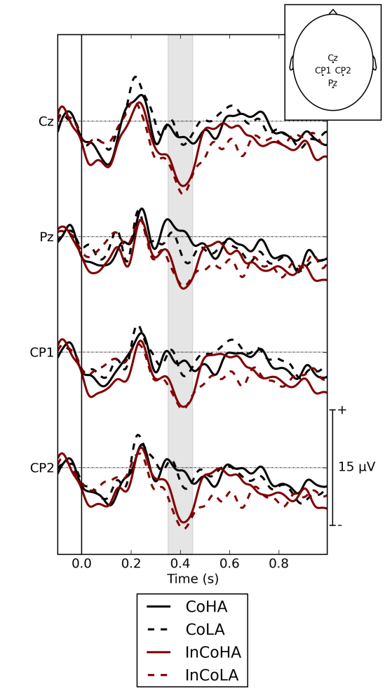
Preliminary results
EEG responses
Position of electrodes on scalp
4 priming cases:
text prime = target, music prime = target
text prime = target, music prime = target
text prime = target, music prime = target
text prime = target, music prime = target
target = prime is congruent with target
target = prime is non-congruent with target
The larger the “dip” the bigger the effect of incongruency

Slide 8
Preliminary Observations
Showing text label, e.g. “Mozart”, and music track, e.g., sequentially is too hard (high memory load): no clear EEG responses
Presenting text label and music track jointly: text label tends to dominate over music track, as shown by EEG responses
Strongest response when both primes are incongruent with target, as shown by EEG responses
More subjects need to be scanned… (we only did a pilot study)

Slide 9
Experiment II
Syntax of music

Slide 10
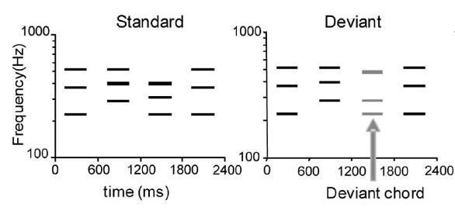
Stimuli
192 melodies (8x 24 scales) (based on Bohlen-Pierce scale recordings of our collaborators in Harvard University, USA)
96 correct melodies: ending on tonic chord
48 melodies with ‘subtle’ violation of the expectations (= in key notes)
48 melodies with ‘frank’ violation (=out of key notes)

Slide 11
Stimuli
Each sequence:
prime = 3 seconds (3 notes)
target = 1000ms (1 note)
Target is always the last note of the sequence

Slide 12
Participants tested until now
5 professional musicians
1 non-musician

Slide 13
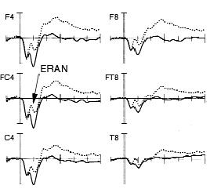
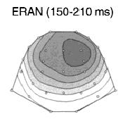
Results: musicians
As in previous research: Early Right Anterior Negativity (ERAN)/ N5 (Koelsch, 2001)
However: we did not find significant amplitude differences between the ‘congruent’ and ‘non-congruent‘ conditions for mild violations although this has been found in previous research (Koelsch, 2001, 2006)
But we did find them for frank violations…

Slide 14
Conclusions
We are taking the first steps in unraveling with EEG the semantic processes involved in joint text & music “priming” on “target” responses
And those involved in syntactic violations (deviant chords) Joret et al. (2017). How Does The Brain Process Mild Versus Strong Violations in Music? A Pilot Study Using Event-Related Potentials. 22nd International Conference on Digital Signal Processing (DSP 2017) (50th Anniversary Edition) (August 23-25, London, United Kingdom), pp. 1-5. doi: 10.1109/ICDSP.2017.8096146

